Slide 1
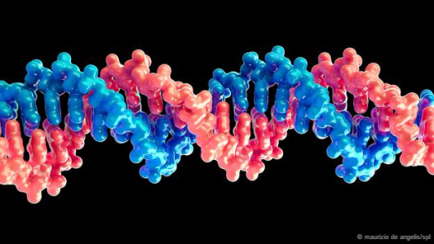
The DNA of a Supervisor
Alternative Title:
“Get Your Hands Out of my Genes!”
FPHRA Annual Conference Master Class 2015

Slide 2
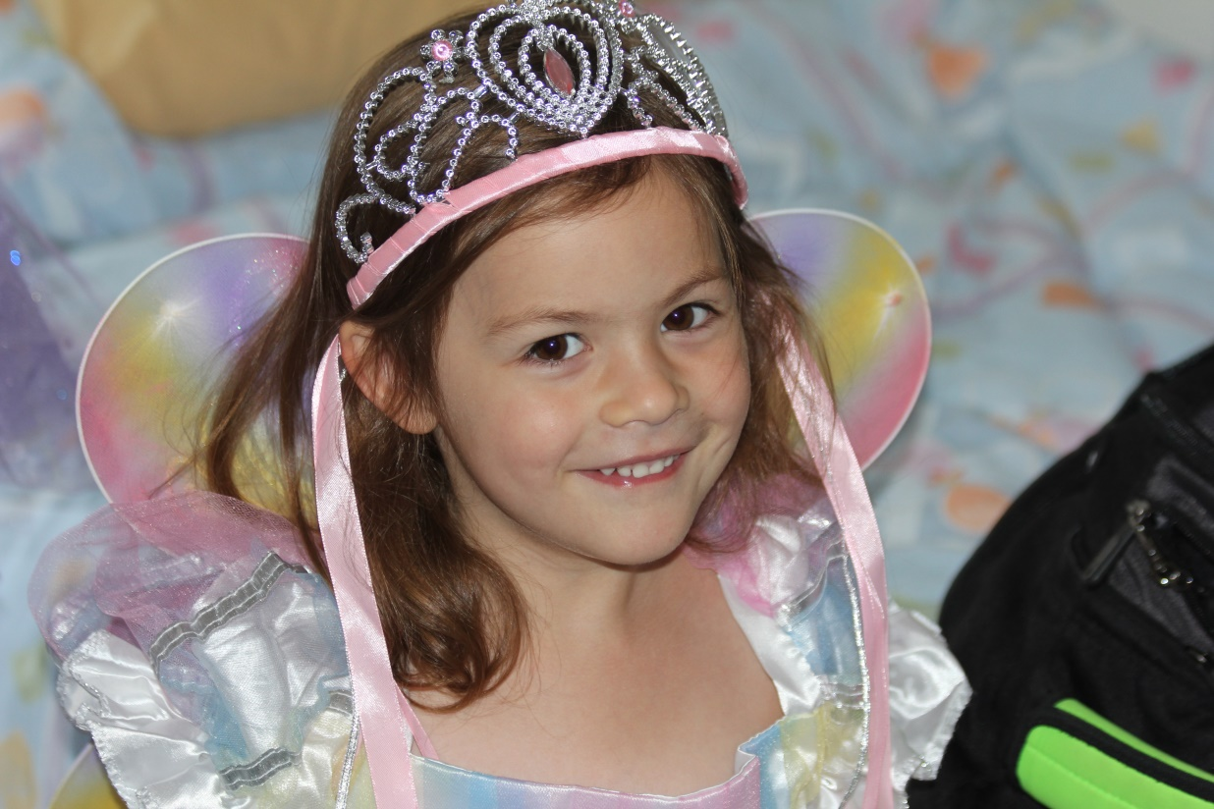
Evie, the Beautiful

Slide 3
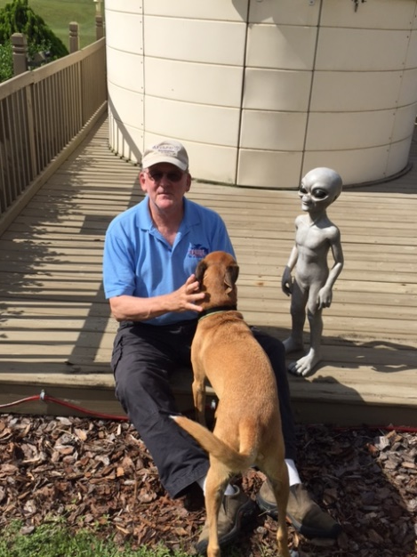
Profound Questions – Emerging Answers
Free Will or Destiny (“Pre-destination”)?
Are some Families or Individuals “Cursed?”
Can we Change our Destiny?
Is Darwin Always Correct?
  Natural Selection
  Evolution?
Can we “Re-engineer” our
  Behavior?
  Our Health?
  Our Relationships?

Slide 4
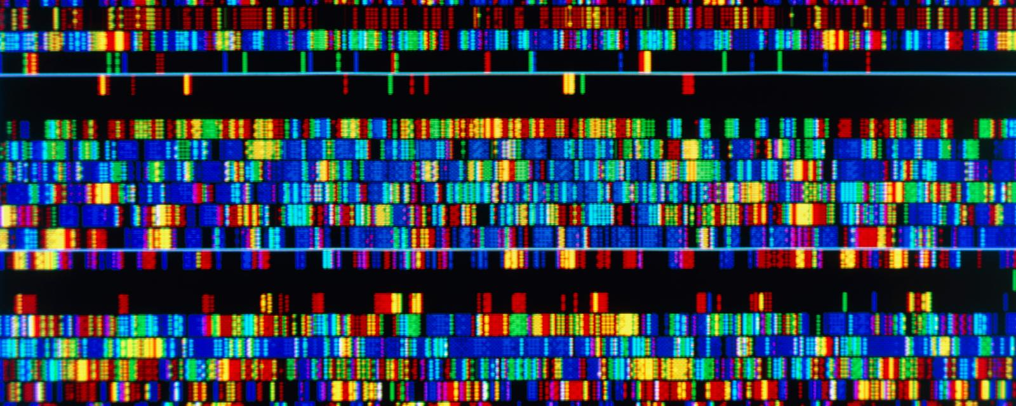
The DNA Mystery and Wonder
23 Pairs of Chromosomes Per Parent
Each contains about 100-150 million Genes
Genes Consist of Strands of DNA
DNA strands consists of Only 4 Substances “A, C, T, G”
  Adenine, Cytosine, Guanine, Thymine
4.6 Billion Possible Pairing Combinations!
96% of our DNA is shared with Chimpanzees; 50% with Bananas

Slide 5
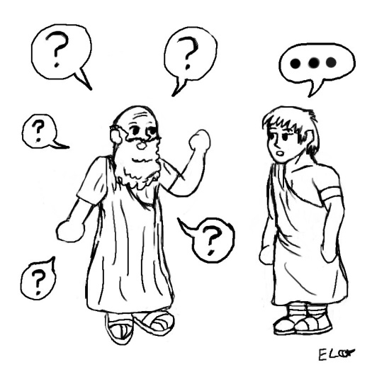
Profound Issues
Were Ancient Myths and Religious Beliefs Correct?
  Some are “Cursed” or “Blessed”
      Genetic Diseases
      Physical Characteristics
Emerging Technologies to Alter these “Curses” or “Blessings”
      Gene Therapy – Stem Cell Therapies
      Trait Selection/Amendment
      Organ Replacement
      Religious/Philosophical Issues
      “Perversions” = Eugenics, Profiling,
      Loss of Imagination and Wonder

Slide 6

We Do (and Have for Thousands of Years) Manipulated Genes & Behaviors
Despite Fears, Worries, Objections
  Animal Husbandry
    Favorite Example = K9s!
  Choosing a Mate
  Creating a Great
    Life Environment

Slide 7

And Now … to HR!
Our efforts to “Manipulate”
  Classification
    Selecting Activities to be performed = “Essential Elements”
    KSA’s
  Recruitment
    Where and How we seek out Candidates
  Employment Testing/Behavioral Interviews, etc.
  Employee Development – Training, Evaluation
  Rules, Regulations, Policies
  Disciplinary Actions
  Rewards

Slide 8

So do Unions…
More: $$, Benefits, Vested Rights, Restrictions on Organizational Options, Control Over Policy-making
or
Less: Management Rights, Flexibility for Managers, Costs for Employees

Slide 9

Critical Role of a Supervisor
Agent of Management: “Respondaet Superior”
“Radar Station”… Scanning the Work Environment for Anomalies, Observing, Reporting, Recommending, Evaluating
Coach, Role Model, Trainer, Inspirational Leader
Agent of Reward and Recognition
Shaper of Subordinate Behaviors
Security Agent, Intervener to Prevent/Mitigate Trouble

Slide 10
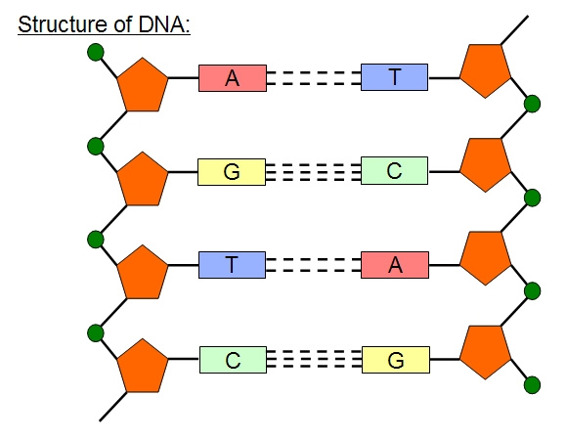
Creating Viable Supervisory “Genetic Modification”
Remember the Essential DNA Components: T, A, G, C,
T:
  Testosterone Overdose Avoidance
  Training and Learning
  Testing: Insuring Job-relatedness, GINA
  Mutuality of Trust
A:
  Aptitude
  Adaptability
  Availability of Help/Support
  Appreciation of Their Role

Slide 11
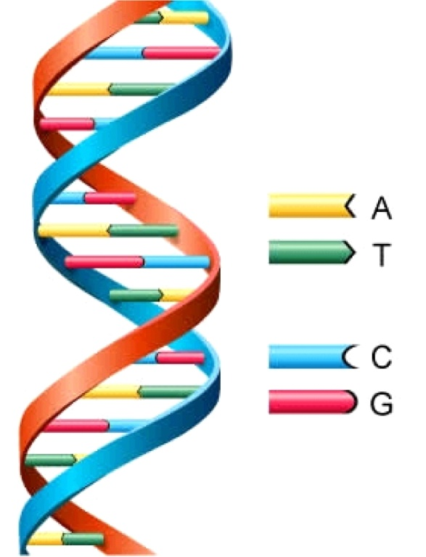
Supervisory DNA Components
G:
  Guidance: Giving it, Getting it
  Gratitude: In Both Directions
  Grace & Humility
C:
  Credibility
  Cognition
  Congeniality

Slide 12

What Makes for a Wonderful Supervisor?

Slide 13
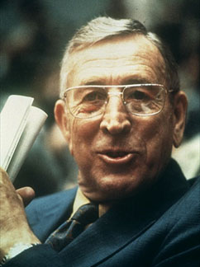
Examples of Great Characteristics
Technical Knowledge
Positive, Optimistic Outlook
“Over the Horizon” Broad Perspective
Sense of Humor
Compassion
Ability to Challenge and Mentor
Communicate Clearly and Concisely
Inspirational Role Modeling
Positive “Mood Contagion”

Slide 14
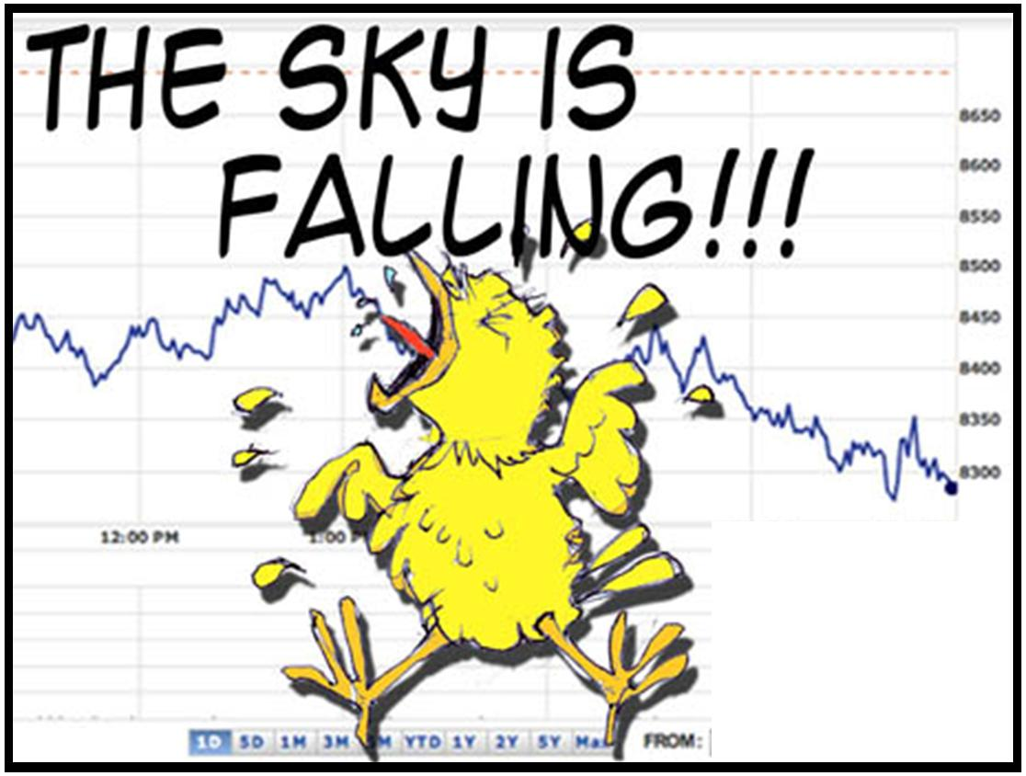
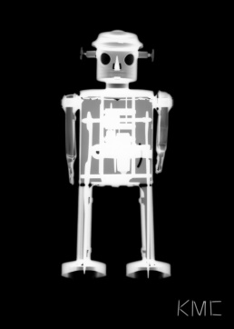
Evolving Dangers in our Profession
Losing the Essential Focus of HR:
  Job-Related Performance & Behavior
Failure of Vigilance; Failure to Act
Failure to Reward, Recognize
“Walking by Something Wrong!”
Taking the “Human” Out of Human Resources
  Metrics
  “One Size Fits All” Policies
  Not Properly Mixing Impersonal Rules with Flexibility & Compassion (The Real HR “Art Form”)

Slide 15

Some Final Thoughts
Remembering the Importance of Fun and Humor
Constant Attention to Developing “the Next Generation” – Imagining What Could Be…
“Over the Horizon” Thinking
Practicing “The HR Art Form”
Enjoying the Mixing of Science and Art
“Find Thyself a Teacher” in Your Own Career & Life
Bringing Forward the Day/Putting Off the Day …
Public Enemy #1 = HUBRIS

Slide 16

Arigato
Malo 'aupito
Спасибо!
Enkosi
Ngiyabonga
Dankie

